Slide 1
IN SEARCH OF OUR MOTHER’S GARDEN

Slide 2
SUMMARY
Walker describes Jean Toomer's exploration of the Reconstruction South. Toomer found women sexually abused and lost, but who he saw to hold power, spirituality and beauty of which they were not aware. They were waiting for these unknowns to be made known. In the meantime they did not appreciate any aspects of life. These black women were artists whose creative forces were abandoned to the hardships of life.
Black women who were able to create such as Phillis Wheatley and Zora Hurston had divided loyalties, between black and white cultures. They were raised in both and their art is not genuinely hers but confused due to this. Many have criticized Wheatley's poetry for glorifying white people but Walker understands that art for Phyllis was a soulful practice and it sustained her.

Slide 3
This is not the end of the story, for the next generation of black women has survived. There is now the quest for black female identity. Society is not understanding of this strife.
The question arises of how so many women were in touch with their spirituality despite of the oppression and abuse.
Walker tells the story of her mother, who eloped at seventeen in the late 1920s. Walker is the youngest of eight children. Her mother worked tirelessly in the fields and at home all day. She found spirituality and creativity in her domestic undertakings, such as the planting of magnificent gardens, the only medium available to her. These expressions of creativity were anonymous, but they live on in Walker's stories. Not only the dry facts live on but their spirit. Walker feels an urgency to preserve them.

Slide 4
When her mother works in the garden, she is brilliant and radiant. She makes beauty within the poverty in which they lived. Such ability is characteristic of black women. Through this exploration of her mother's heritage she found her expressive creativity. In this way, many other mothers leave their marks on their children, and inspire them through the spirit and beauty that they recognized to create themselves.

Slide 5
SYMBOLISM
In Alice Walker’s Text In Search of Our Mother’s Gardens Walker, represents the hardships and strength of African American women. Walker specifically talks about her mother and grandmother and how they have shaped her to learn about her history. Throughout the story, Walker uses the word garden. I believe this word symbolizes strength, courage, and care. The garden was a way for her mother to do something that she loves, and puts her heart and soul into. Black women didn’t have it easy in the past. In the story, Walker explained how her grandmother wasn’t able to let out their talents back in the day. Black women did everything, but was never acknowledge for what they have done. Black women had to do what their masters said, and always do it right.

Slide 6
Something that was important to her mother was the garden. She mentioned that people from all over the world. and in the community would come to see her garden. It was something she had a passion for and love. Her mother never gave up and kept doing what she had to do. The garden was something she would make sure looked nice daily, kept the look of the garden complete and beautiful, and showed her the true meaning of loving a passion.

Slide 7
My garden would be football. Football is an activity that I love and take serious. It is a sport I have been active at for most of my life, and have learned so many skills and have been on various teams each year. It is a sport I am able to improve in and help others improve as well. Football is a sport that is important to me like the garden is important to Walker’s mother. Everyone has a specific garden of theirs, they juts have to find it and make a positive change out of what one does!

Slide 8
“Virginia Wolf, in her book A Room of one’s own, wrote that in order for a woman to write fiction she must have two things, certainly: a room of her own(with key and lock) and enough money to support herself.”

Slide 9
PHILLIS WHEATLEY
Phillis Wheatley, also spelled Phyllis and Wheatly (c. 1753 – December 5, 1784) was the first published African-American female poet. Born in West Africa, she was sold into slavery at the age of seven or eight and transported to North America. She was purchased by the Wheatley family of Boston, who taught her to read and write and encouraged her poetry when they saw her talent.

Slide 10
The publication of her Poems on Various Subjects, Religious and Moral on September 1, 1773 brought her fame both in England and the American colonies. Figures such as George Washington praised her work. During Wheatley's visit to England with her master's son, African-American poet Jupiter Hammon praised her work in his own poem. Wheatley was emancipated (set free) shortly after the publication of her book. She married in about 1778. Two of her children died as infants. After her husband was imprisoned for debt in 1784, Wheatley fell into poverty and died of illness, quickly followed by the death of her surviving infant son.

Slide 11
PRESENT CONDITIONS
“In Search of our Mothers’ Garden”, which is a personal account that is yet shared, in its theme and meaning by all of us .
It reminds us of how we take our own mother’s love and sacrifices which we take for granted some times. Some of our mothers even handle a careers beside all household chores.

Slide 12
The black immigrant population has increased fivefold since 1980.Immigrants are making up a growing number of the overall U.S. population – but the black immigrant population is growing twice as fast. There were 4.2 million black immigrants living in the U.S. in 2016, up from 816,000 in 1980, according to a Pew Research Center analysis of census data. Since 2000 alone, the number of black immigrants in the U.S. has risen 71%.

Slide 13
A growing share of blacks are completing high school and college. For the first time in U.S. history, 90% of Americans ages 25 and older have completed high school, according to the U.S. Census Bureau – and the share of blacks who have done so is also at the highest level on record. In 2017, 87% of blacks ages 25 and older had a high school diploma or equivalent. Although the high school completion rate for non-Hispanic whites was higher (94%) than for blacks, the gap has been gradually shrinking. In 1993, the high school completion gap was twice as large (14 percentage points) as it is today (7 points). The share of blacks ages 25 and older who have completed four years of college or more has also roughly doubled during that span, from 12% in 1993 to 24% in 2017.

Slide 14
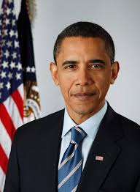
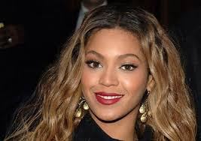
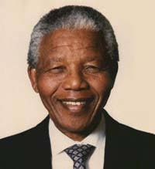
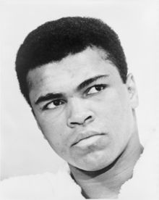
Famous Colored Men and Women

